Slide 1



Presented By Group-6
FORECASTING APPLE STOCK MARKET PRICE

Slide 2



Business Objective
Develop a robust predictive model that accurately forecasts Apple’s closing stock price for the next 30 days.

Slide 3

INTRODUCTION
Accurately forecasting Apple Inc.'s stock price over a 30-day period is challenging due to market volatility and external factors. This project utilizes over seven years of historical daily data to develop a predictive model for Apple's closing price. By analyzing both short-term and long-term trends, and assessing the impact of external factors, we aim to provide actionable insights to assist investors and analysts in making informed decisions

Slide 4


Project Architecture
Exploratory Data Analysis
Data Visualization
Data Preprocessing
Data Partitions
Model Building
Model Evaluation
Performance Comparison
Deployment

Slide 5

DATA SET
d
The dataset used for this project consists of historical stock price data for Apple Inc. from 2012 to 2019. It includes daily stock market data with the following key features:
Date – The trading date for each record.
Open Price – The stock price at the beginning of the trading session.
High Price – The highest stock price recorded during the trading session.
Low Price – The lowest stock price recorded during the trading session.
Close Price – The final stock price at the end of the trading session.
Volume – The number of shares traded on that particular day.

Slide 6

SHAPE: NULL VALUES:
2011 row’s No Null Value’s
column’s
DATA TYPE: DUPLICATES:
Object No Duplicate Value’s
Float64
int64
DATA DESCRIPTION

Slide 7


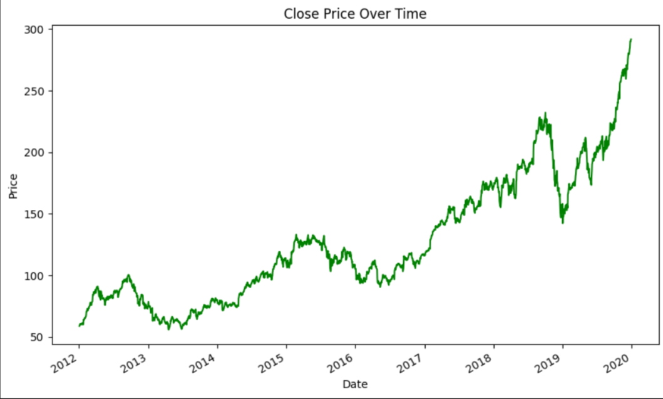

DATA VISUALIZATION
- The plot shows the closing price of the apple stock market price from 2012 to 2019. The trend shows close price gradually increases by the period of time.

Slide 8
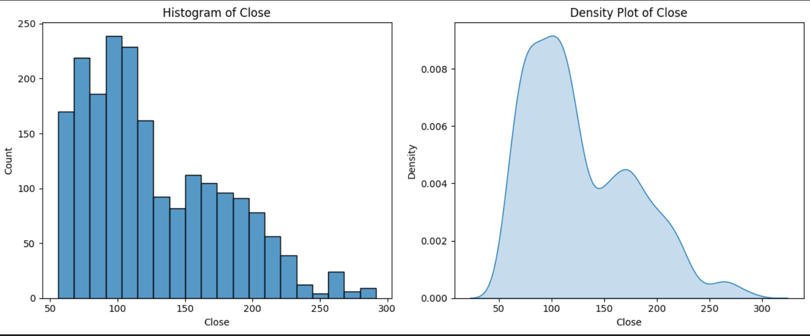
DATA VISUALIZATION
-
- The count of histogram of close price and density plot is in decreasing manner. While it reaches to 300 closing price

Slide 9
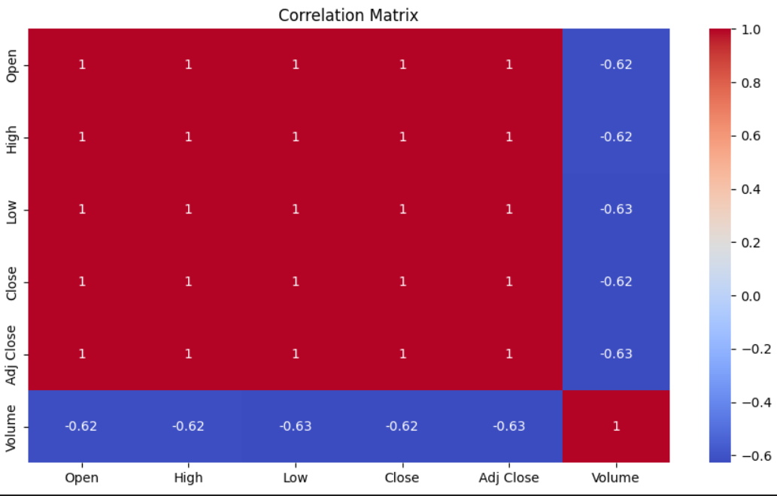
DATA VISUALIZATION

Slide 10
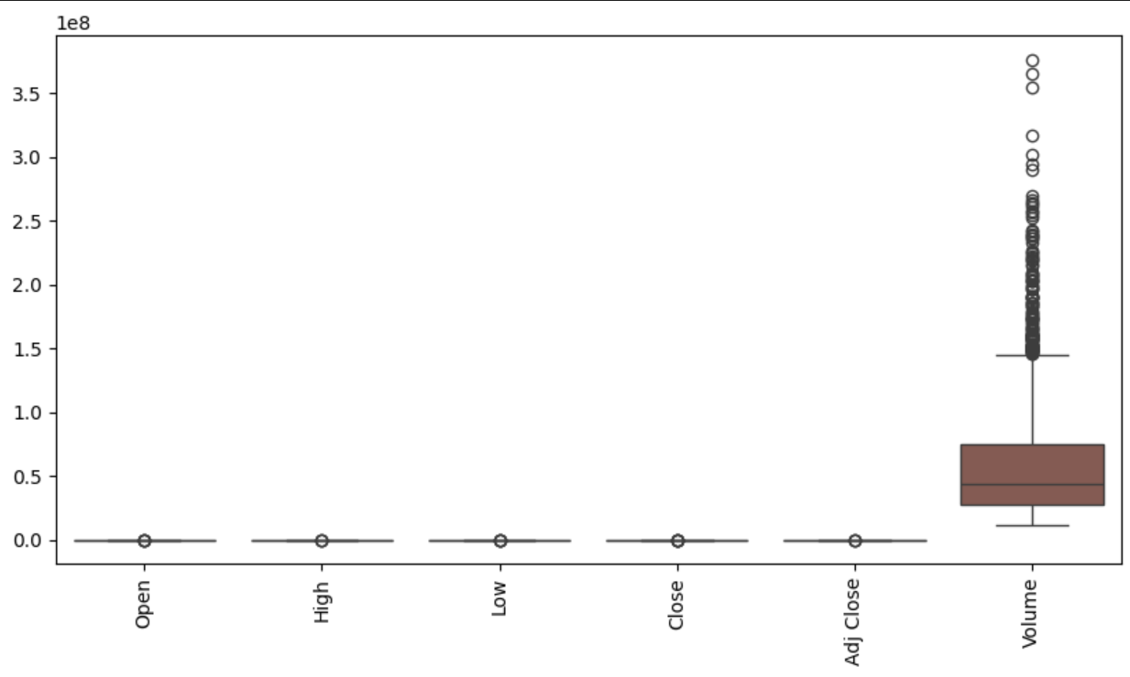
DATA VISUALIZATION
The volume column has highest outliers is above 3.5 le8 and Remaining columns have outliers. But, it equal to 0.0.

Slide 11
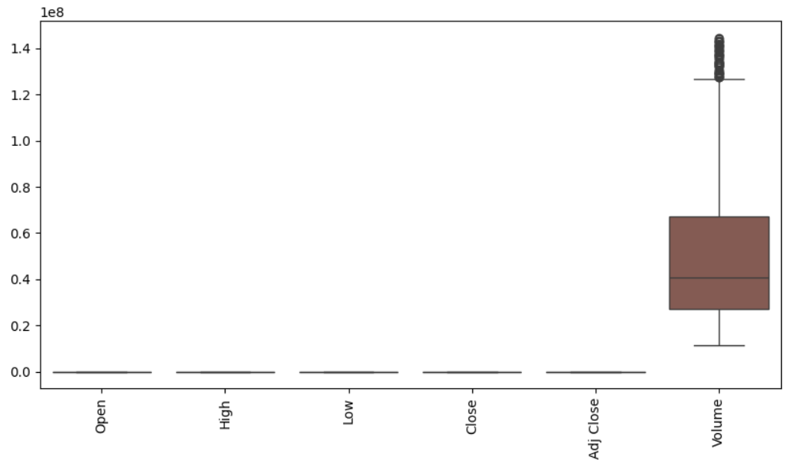
DATA VISUALIZATION
- After treating outliers. The volume column reduces to 1.4 le8 0 and the remaining columns doesn’t have outliers.

Slide 12
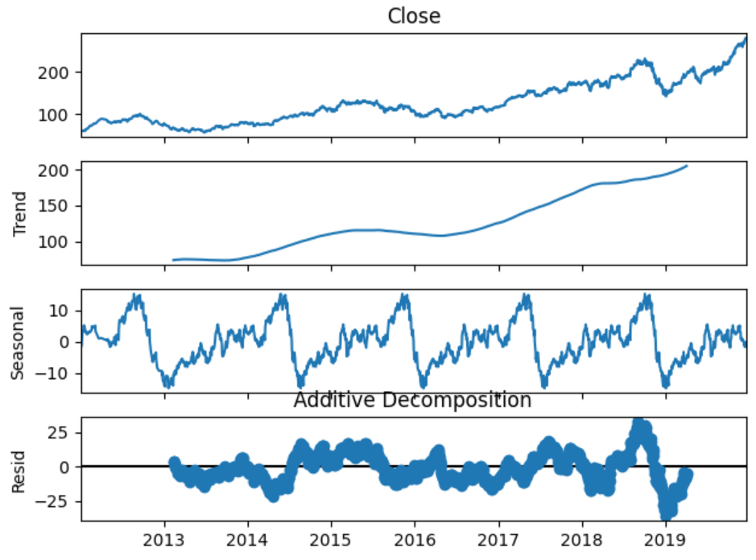
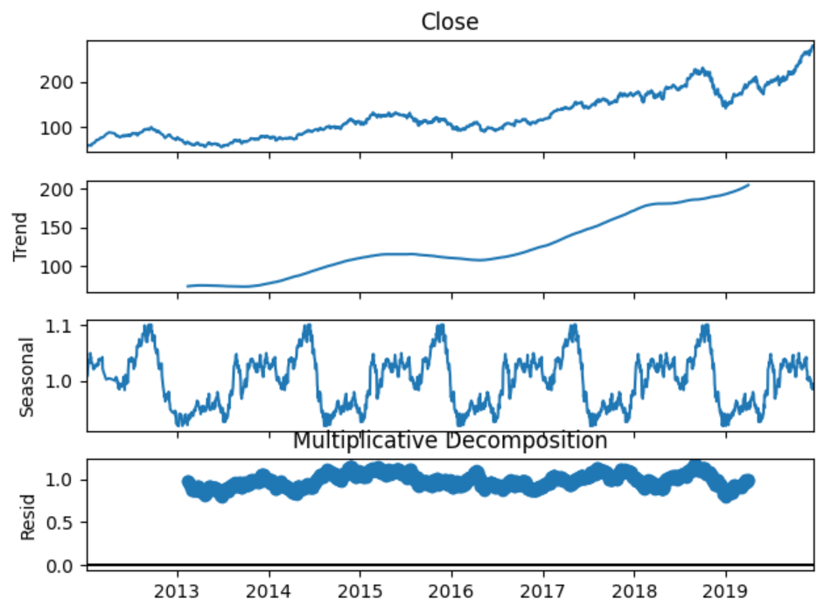
DATA VISUALIZATION
Additive Residual variance is: 108.5232130018875
Multiplicative Residual Variance is: 0.005713966394712335
The multiplicative model demonstrates a lower residual variance, making it a more suitable fit for data.
With it’s reduced variance, the multiplicative model is preferred for this particular dataset.

Slide 13
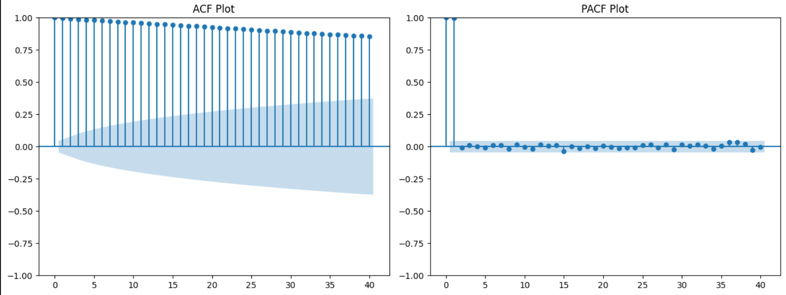
DATA VISUALIZATION
Strong autocorrelation, revealed by the high and gradually declining ACF values, indicates a non-stationary
time series requiring differencing.
The PACF's strong lag-1 correlation, with other lags insignificant, points to an AR(1) process.
This AR(1) process suggests the series' current value is heavily dependent on its immediate predecessor.
Essentially, the time series exhibits a first-order autoregressive behavior due to its non-stationarity and lag-1
dominance.

Slide 14
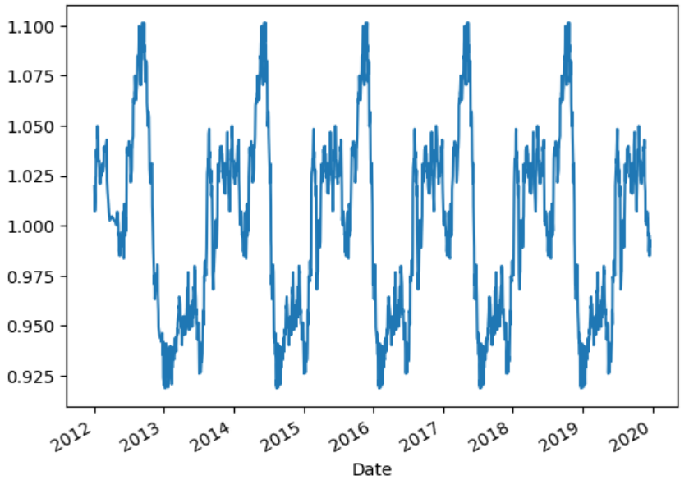
DATA VISUALIZATION
Seasonal price variations are evident in the distribution show in the plot.
The data spans from 2012 to 2019.
The plot highlights the fluctuations over these years.

Slide 15
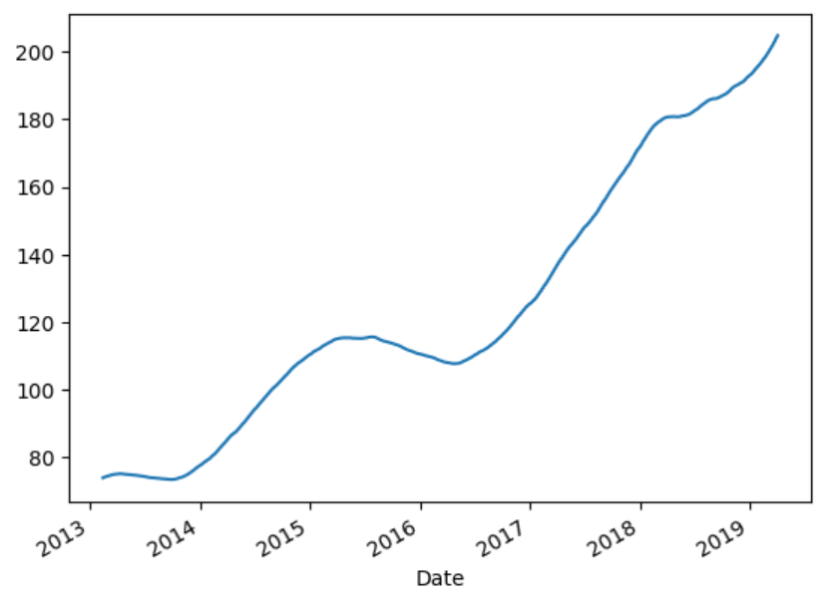
DATA VISUALIZATION
Over the 2013 to 2019 period, the trend plot shows variations up to 200 units.
This plot exhibits an overall increasing pattern.

Slide 16
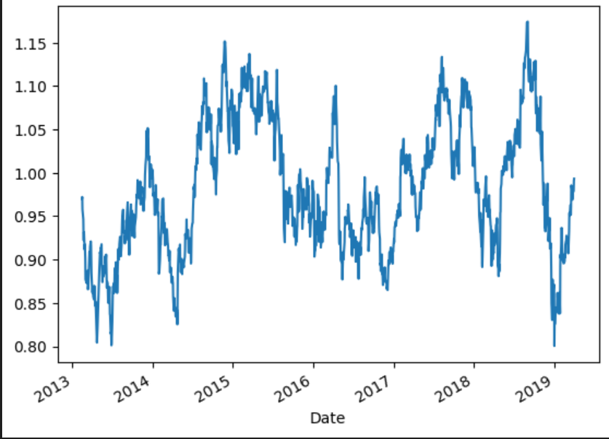
DATA VISUALIZATION
Analyzing the residual plot from 2013 to 2019 reveals a period of ups and downs.
Beyond 2019 a clear increasing trend is observed.

Slide 17
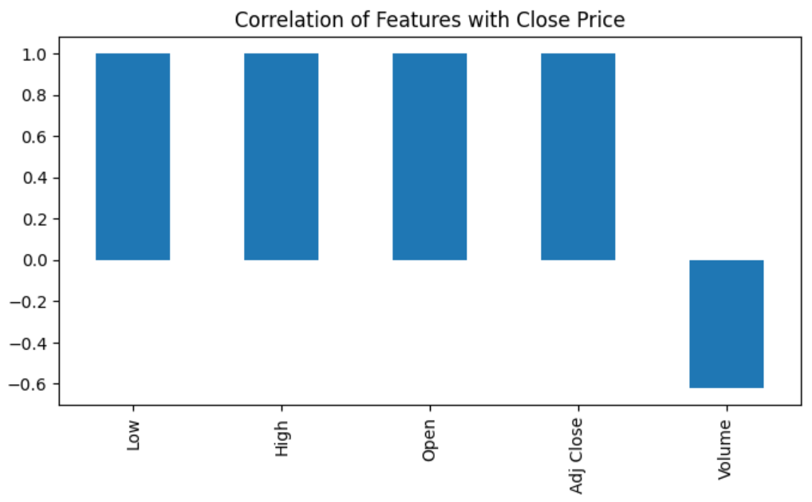
DATA VISUALIZATION
A positive correlation is observed among the low, high, open, and adjusted close prices.
Volume demonstrates a negative corration with these price points.

Slide 18
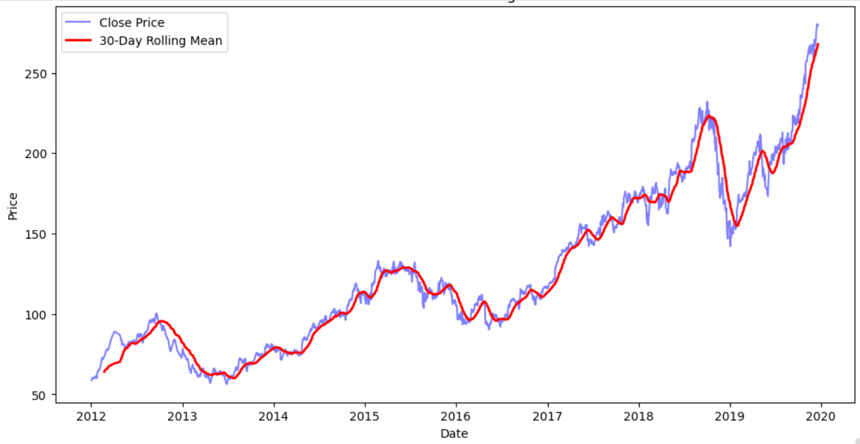
DATA VISUALIZATION
An increasing trend is observed in both the closing price and its 30-day rolling mean.
These two metrics move in a similar upward direction.
This reinforces the observation of a positive trend.

Slide 19
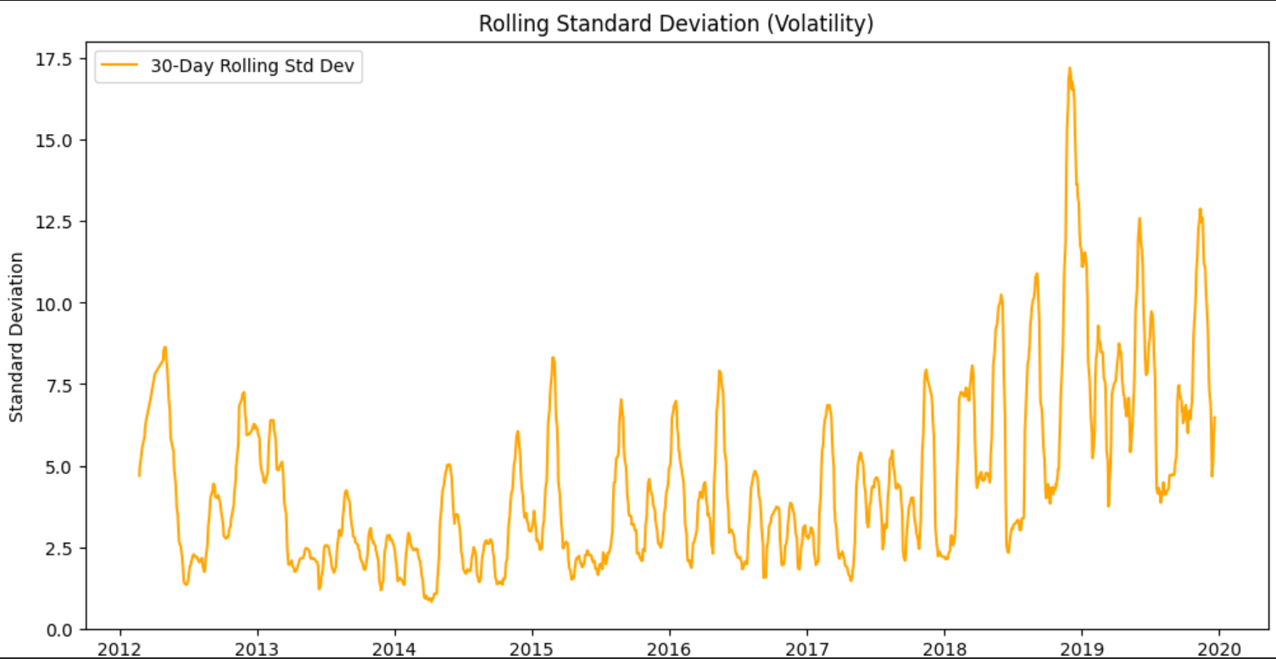
DATA VISUALIZATION
- The rolling standard deviation exhibits significant volatility with frequent fluctuations. Post-2018, an increasing trend is observed.

Slide 20
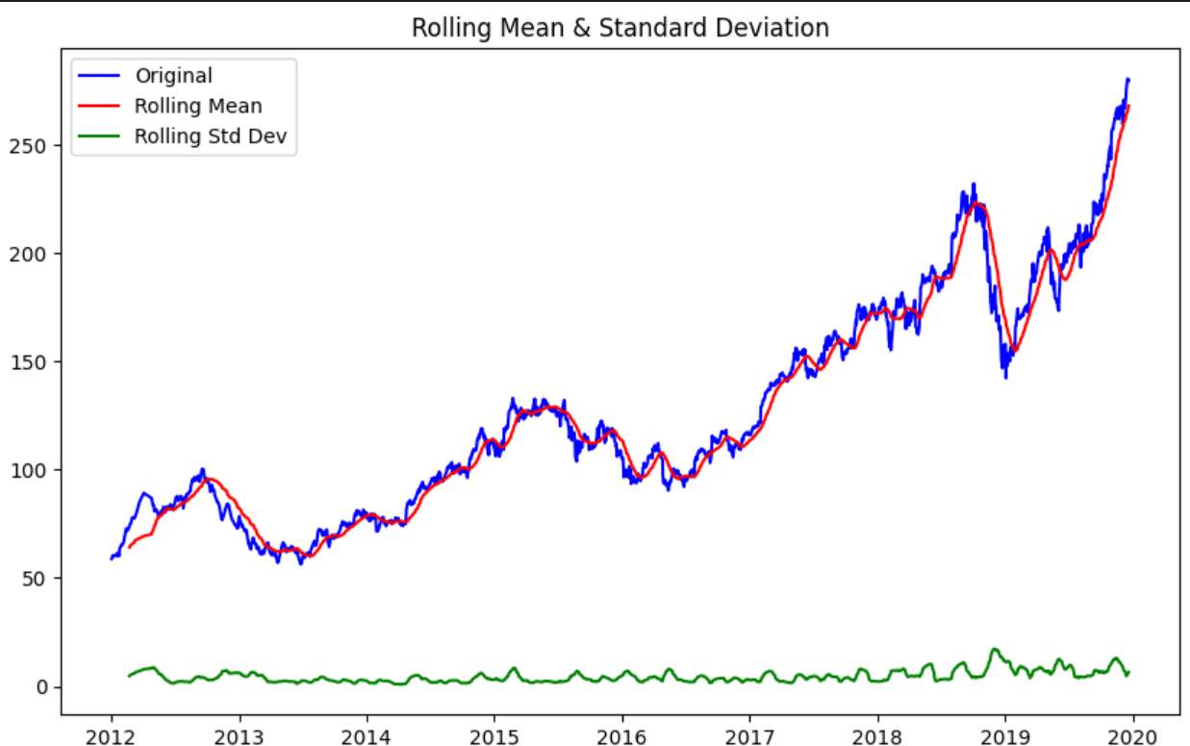
DATA VISUALIZATION
Both original data and its rolling mean demonstrate a similar directional movement.
In contrast, the rolling stanard deviation remains relatively stable showing a negligible trend.

Slide 21
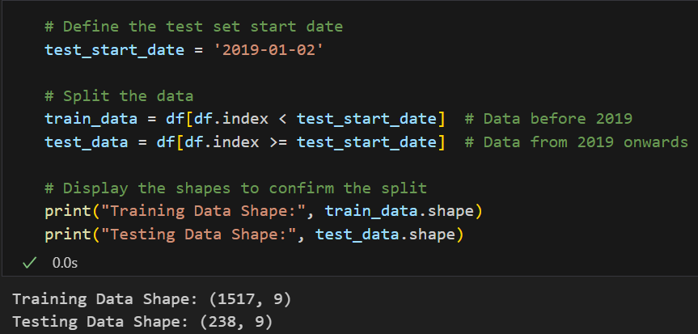
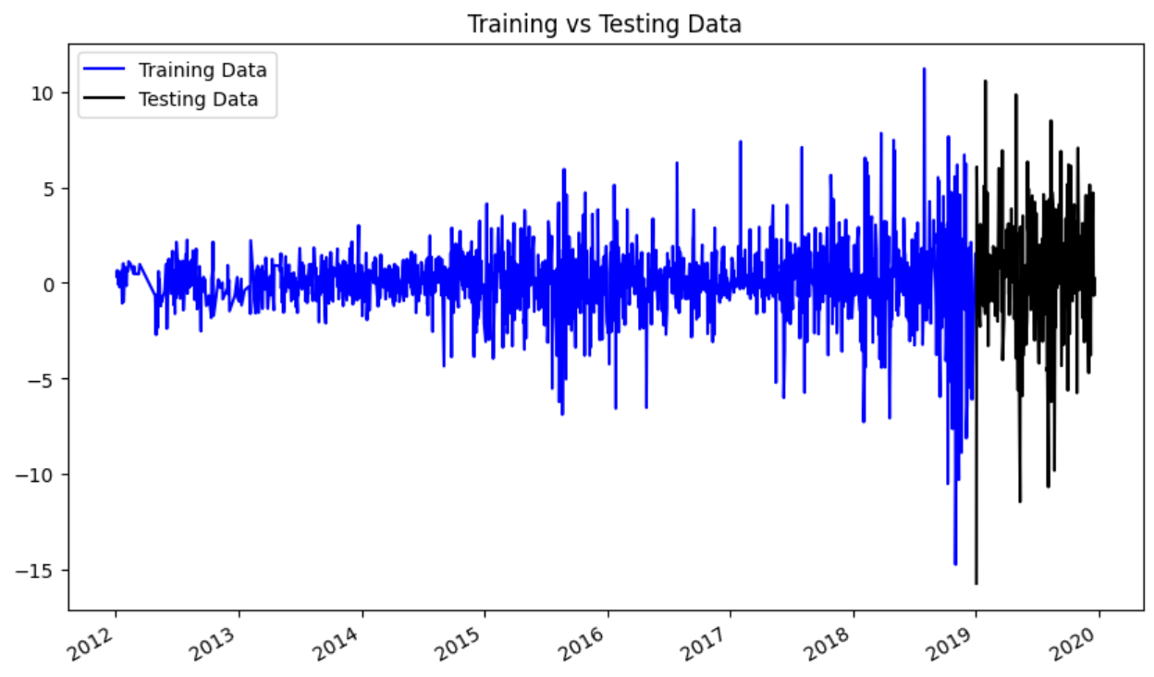
SPLITTING TRAIN AND TEST SET

Slide 22
ALGORITHMS
We have used the balanced dataset to build the following models.
ARIMA MODEL
SARIMA MODEL
SIMPLE EXPONENTIAL SMOOTHING
DOUBLE EXPONENTIAL SMOOTHING(HOLT’S LINEAR)
TRIPLE EXPONENTIAL SMOOTHING(HOLT’S WINTER’S)

Slide 23
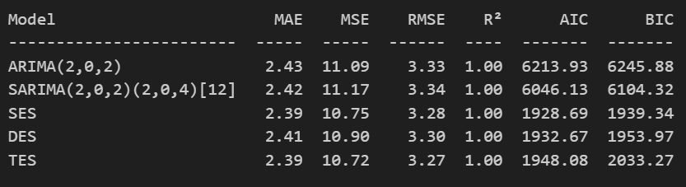
MODEL’S
The AIC and BIC has high values and mean absolute error and mean square error is also low. So, we finalize “TRIPLE EXPONENTIAL SMOOTHING” model.

Slide 24
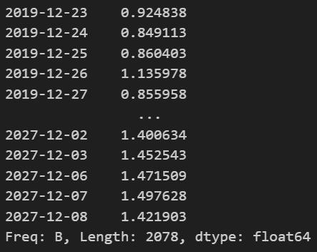
PREDICTION
- These are prediction for the next 30 days with respect to dates.

Slide 25
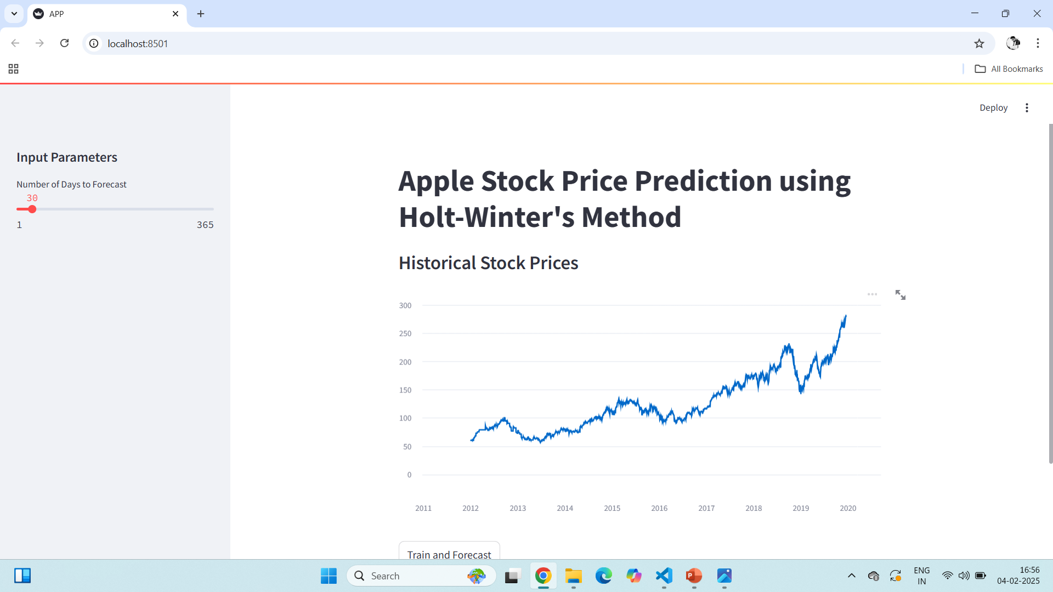
STREAMLIT WEB PAGE

Slide 26
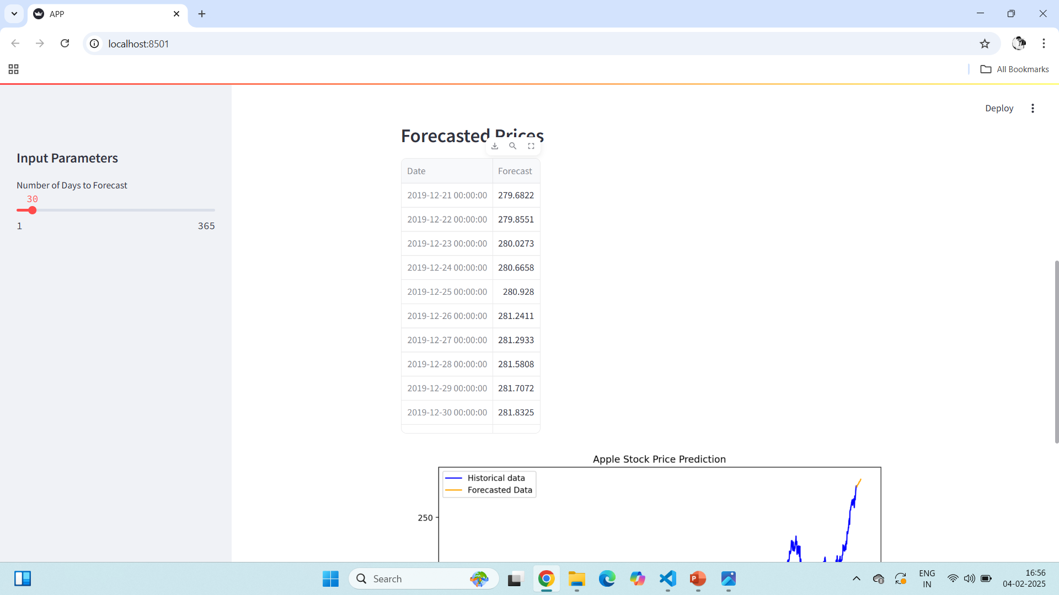
PREDICTION
- Forecasting the next 30 days

Slide 27
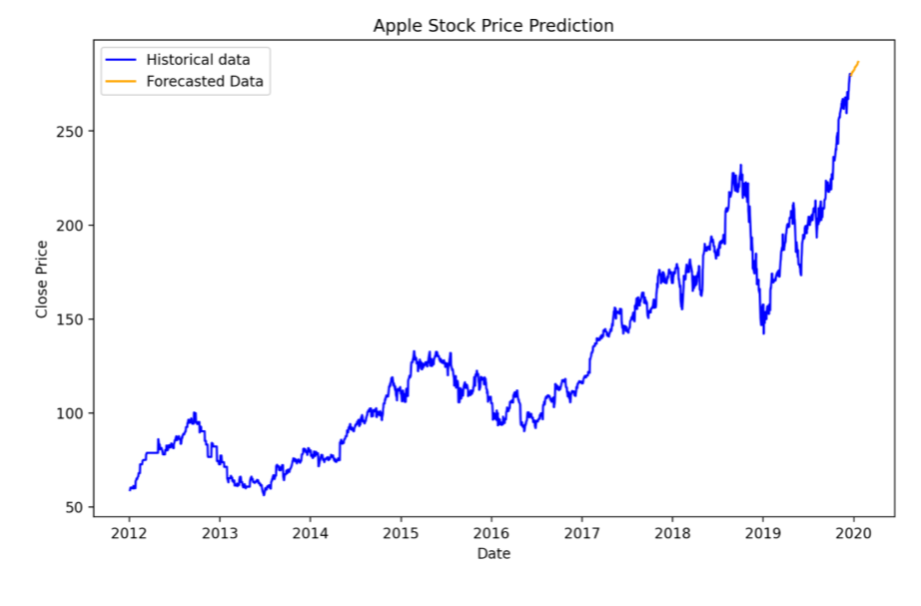
PREDICTION
- Graph for the next 30 days

Slide 28
KEY CHALLENGES
Non-stationarity, stemming from trends and seasonality in the stock price data, necessitated a differencing transformation for model suitability. (Addresses Non-Stationarity)
The presence of outliers demanded careful preprocessing to mitigate their potential influence on the forecasting accuracy. (Addresses Outliers)
Model selection proved challenging, requiring rigorous evaluation of multiple forecasting models to determine the optimal fit for the specific data characteristics. (Addresses Model Selection)
Thorough residual analysis was crucial, employing statistical tests to confirm normal distribution and absence of autocorrelation in the model's residuals. (Addresses Residual Analysis)
These steps ensured the reliability and validity of the chosen model for stock price forecasting. (Summarizes the importance of the steps)
Addressing these key challenges is essential for generating accurate and robust stock price predictions. (Concludes with the overall goal

Slide 29
OVER COME
Outliers were addressed using appropriate detection techniques to ensure data quality.
First-order differencing was employed to transform the data into a stationary series.
The Holt-Winters model was chosen for its minimal error and robust performance.
ACF and PACF plots were generated to assess autocorrelation and model order.
A histogram was used to examine the distribution and check for normality of the data.

Slide 30


Thank You
@ree
reallygreatsite.com
+123 456 7890

